Slide 1
CSC291 - Software Engineering Concepts
By
Dr. Junaid Akram
Assistant Professor, Department of Computer Science COMSATS (Lahore)

Slide 2
Requirements Modelling
Scenario based modelling
Class based modelling
Functional modelling
Behavioural modelling

Slide 3
Requirement Analysis
Requirements analysis
Specifies software’s operational characteristics
Indicates software's interface with other system elements
Establishes constraints that software must meet
Requirements analysis allows the software engineer to:
Elaborate on basic requirements established during earlier requirement engineering tasks
Build models that depict user scenarios, functional activities, problem classes and their relationships, system and class behavior, and the flow of data as it is transformed.

Slide 4
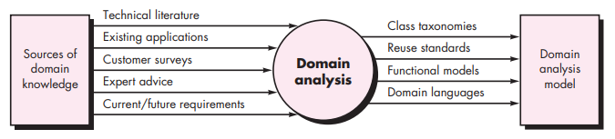
Domain Analysis
Define the domain to be investigated.
Collect a representative sample of applications in the domain.
Analyze each application in the sample.
Develop an analysis model for the objects.

Slide 5
Requirement Modelling
The intent of the requirement model is to provide a description of the required informational, functional, and behavioral domains for a computer-based system.
The model changes dynamically as you learn more about the system to build.
An approach that has a higher probability of uncovering omissions, inconsistencies, and ambiguity.

Slide 6
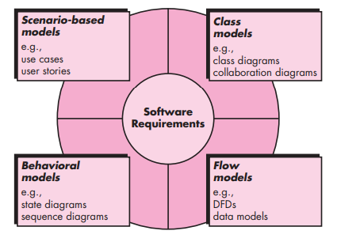
Requirement Modelling

Slide 7
Scenario-based Modelling
The scenarios often called use cases, proved a description of how the system will be used.
In essence, a use case tells a stylized story about how an end user interacts with the system under a specific set of circumstances.
The story can be a narrative text, an outline of tasks or interactions, a template-based description, or a diagrammatic representation.

Slide 8
Scenario-based Modelling- Use case
A collection of user scenarios that describe the thread of usage of a system
Each scenario is described from the point-of-view of an “actor”—a person or device that interacts with the software in some way (not necessarily users) to External entities.
Once actors are defined, use cases can be developed.
Each scenario answers the following questions:
Who is the primary actor, the secondary actor (s) ( to support the primary actors)?
What are the actor’s goals?
What preconditions should exist before the story begins?
What main tasks or functions are performed by the actor?
What extensions might be considered as the story is described?
What variations in the actor’s interaction are possible?
What system information will the actor acquire, produce, or change?
Will the actor have to inform the system about changes in the external environment?
What information does the actor desire from the system?
Does the actor wish to be informed about unexpected changes?

Slide 9
Use case
system name
system boundary
ATM System
primary actor
1
Withdraw
Money
secondary actor
2
Deposit
Money
Bank Customer
Customer Accounts Database
3
Transfer
Money
role
association
4
Check
Balance
<<Customer
Accounts
Database>>
use case
alternative actor notation
stereotype

Slide 10
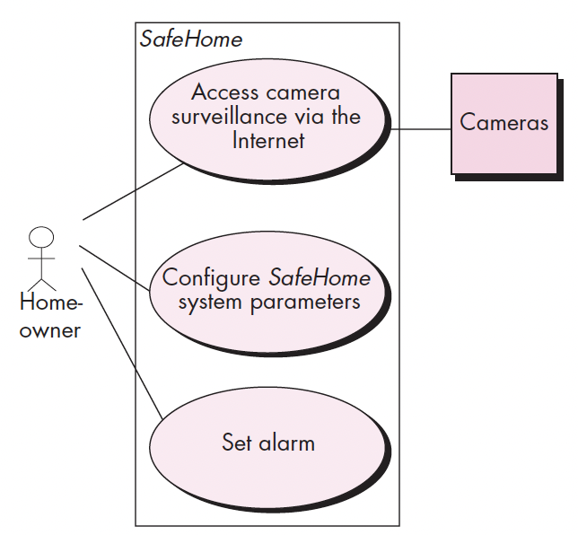
Use-Case diagram for SafeHome system

Slide 11
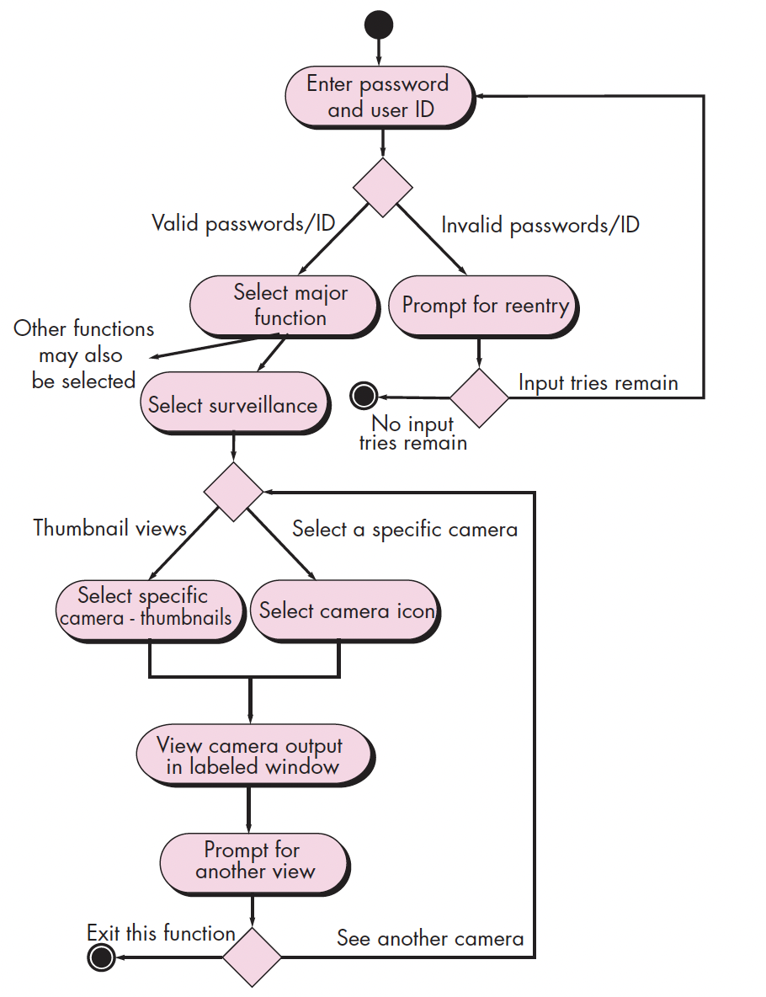
Activity diagram for Access camera surveillance

Slide 12
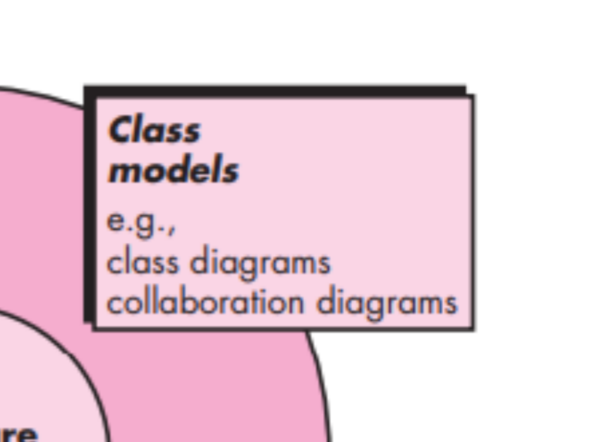

Slide 13
Class-based Modelling
It shows the classes of the system, their inter-relationships, and the operations and attributes of the classes
Explore domain concepts in the form of a domain model
Analyze requirements in the form of a conceptual/analysis model

Slide 14
Class-based Modelling
Class-based modeling represents:
objects that the system will manipulate
operations (also called methods or services) that will be applied to the objects to effect the manipulation
relationships (some hierarchical) between the objects
collaborations that occur between the classes that are defined.

Slide 15
Identifying Classes
Classes are determined by underlining each noun or noun phrase and entering it into a simple table.
If the class (noun) is required to implement a solution, then it is part of the solution space; otherwise, if a class is necessary only to describe a solution, it is part of the problem space.

Slide 16
Class
A class is a description of a set of
objects that share the same attributes,
operations, relationships, and semantics.
Graphically, a class is rendered as a
rectangle, usually including its name,
attributes, and operations in separate,
designated compartments.
ClassName
attributes
operations

Slide 17
Class Name
ClassName
The name of the class is the only required tag in the graphical representation of a class. It always appears in the top-most compartment.
attributes
operations

Slide 18
Class Attributes
Person
An attribute is a named property of a class that describes the object being modeled.
In the class diagram, attributes appear in the second compartment just below the name-compartment.
name : String
address : Address
birthdate : Date
CNIC : Id

Slide 19
Class Operations
Person
name : String
address : Address
birthdate : Date
CNIC : Id
eat
sleep
work
play
Operations describe the class behavior
and appear in the third compartment.

Slide 20
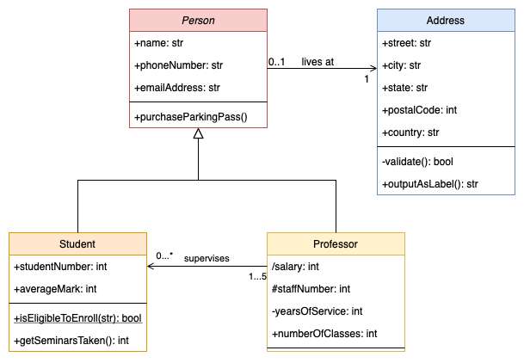
Class Diagram - Example

Slide 21
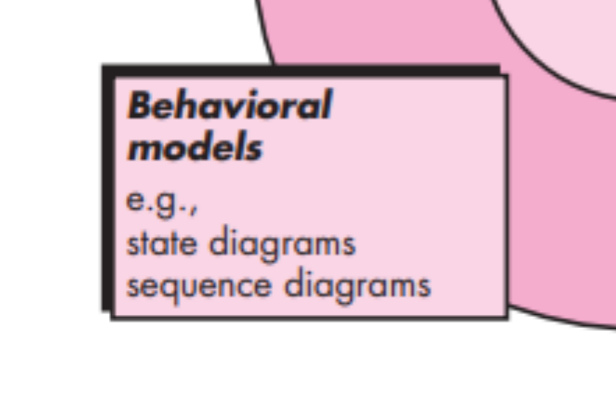

Slide 22
Behavioral Modelling
State diagram is a type of behavioral model
Depicts data and behavior of a single object throughout its lifetime.
Elements of State Diagram
set of states (including an initial start state)
transitions between states
entire diagram is drawn from that object's perspective

Slide 23
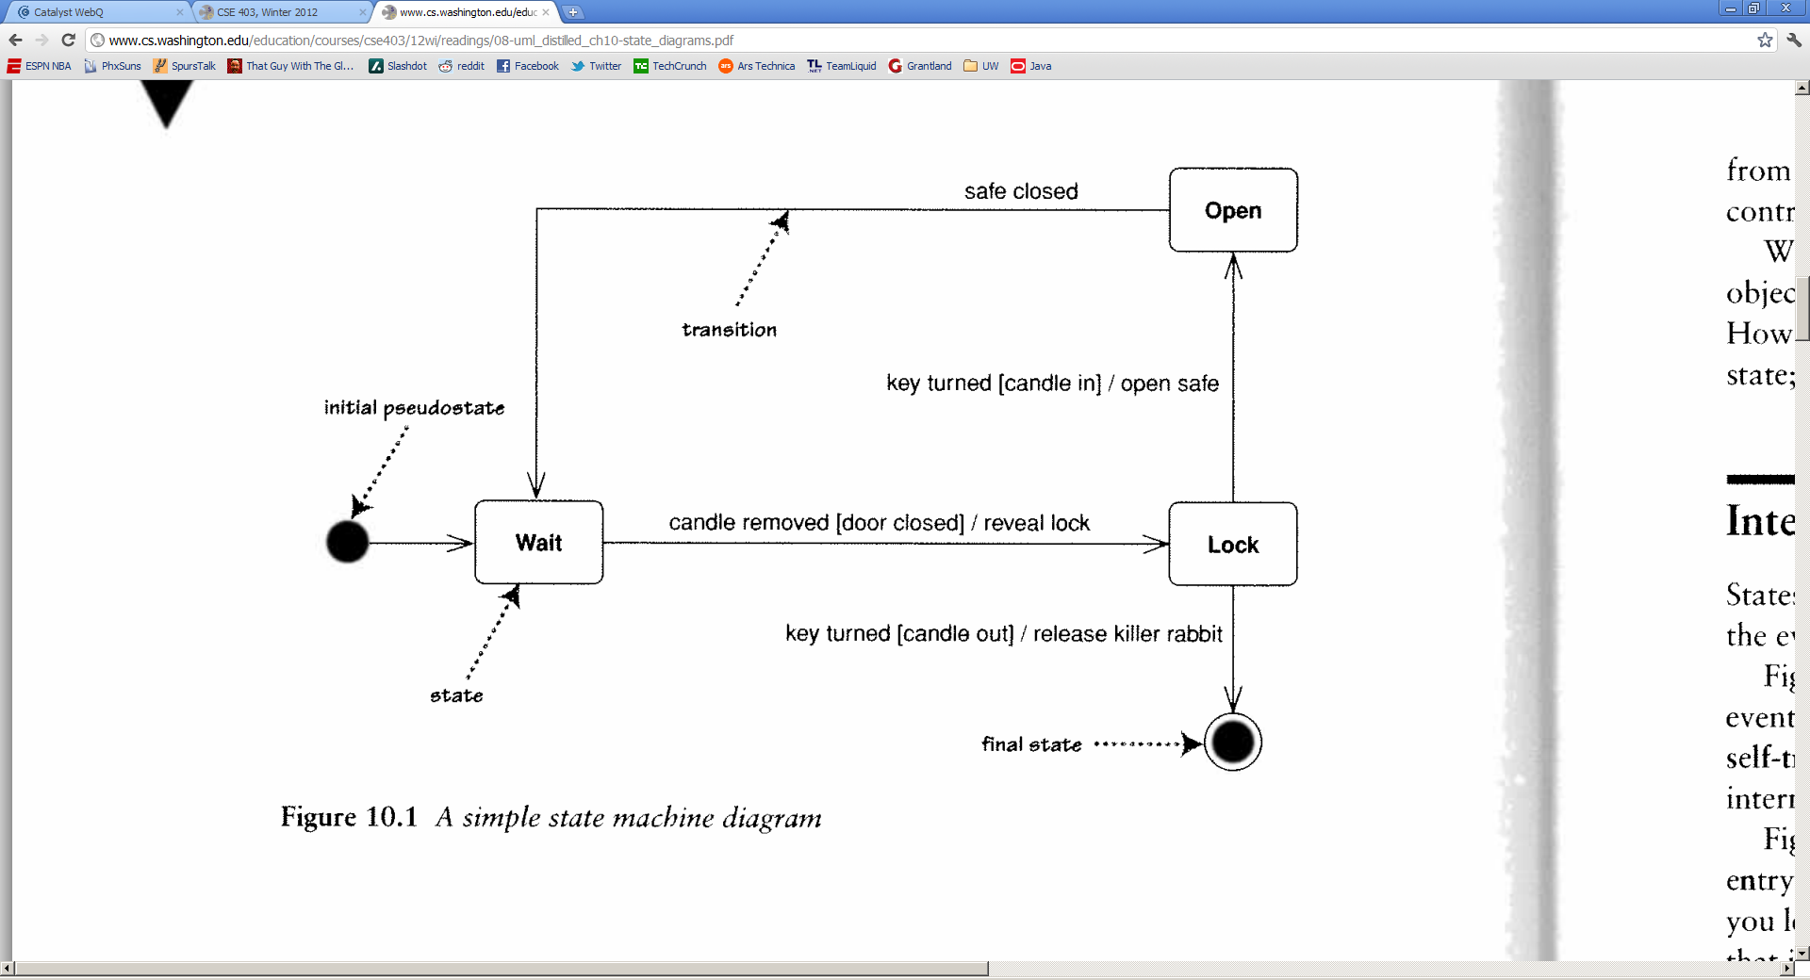
States
State: conceptual description of the data in the object
represented by object's field values
Entire diagram is drawn from the central object's perspective
only include states / concepts that this object can see and influence
don't include every possible value for the fields; only ones that are conceptually different

Slide 24
State Diagram

Slide 25
Sequence Diagrams
Describe the flow of messages, events, actions between objects
Show concurrent processes and activations
Show time sequences that are not easily depicted in other diagrams
Typically used during analysis and design to document and understand the logical flow of your system
Emphasis on time ordering!

Slide 26
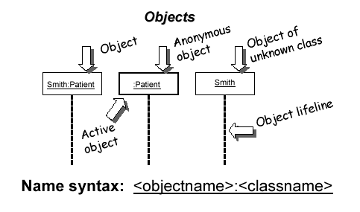
Representing objects
Squares with object type, optionally preceded by object name and colon
write object's name if it clarifies the diagram
object's "life line" represented by dashed vert. line

Slide 27
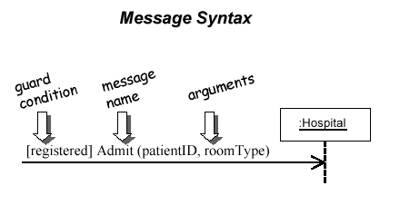
Messages between objects
message (method call) indicated by horizontal arrow to other object
write message name and arguments above arrow

Slide 28
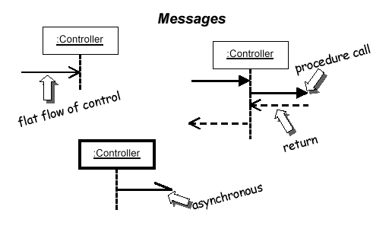
Messages, continued
Message (method call) indicated by horizontal arrow to other object
dashed arrow back indicates return
different arrowheads for normal / concurrent (asynchronous) methods

Slide 29
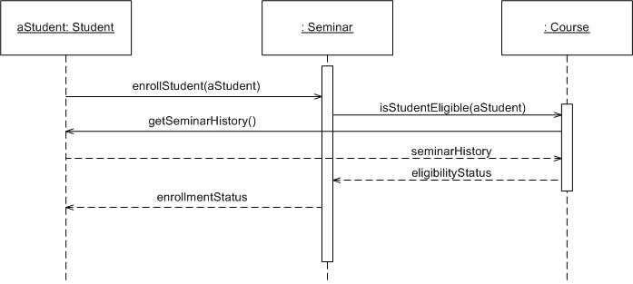
Sequence Diagram
Time Increasing -->
All lines should be horizontal to indicate instantaneous actions. Additionally if ActivityA happens before ActivityB, ActivityA must be above activity A
Lower = Later!

Slide 30
Components
Objects: aStudent is a specific instance of the Student class
Generic (unnamed) objects
Generic (unnamed) objects of class type Seminar
and Course
Specific
Instance of an
Object

Slide 31
Components
execution
lifeline

Slide 32
Components
Method call
Return value

Slide 33
Components
c : Client
o : ODBCProxy
create()
: Transaction
setActions(a, b, c)
setValues(a, 3, 4)
setValues(b, c, 7)
(committed)
destroy()
create()
destroy()
Message
Return message

Slide 34
Summary
Sequence diagrams model object interactions with an emphasis on time ordering
Method call lines
Must be horizontal!
Vertical height matters! “Lower equals Later”
Label the lines
Lifeline – dotted vertical line
Execution bar – bar around lifeline when code is running
Arrows
Synchronous call (you’re waiting for a return value) – triangle arrow-head
Asynchronous call (not waiting for a return) – open arrow-head
Return call – dashed line

Slide 35
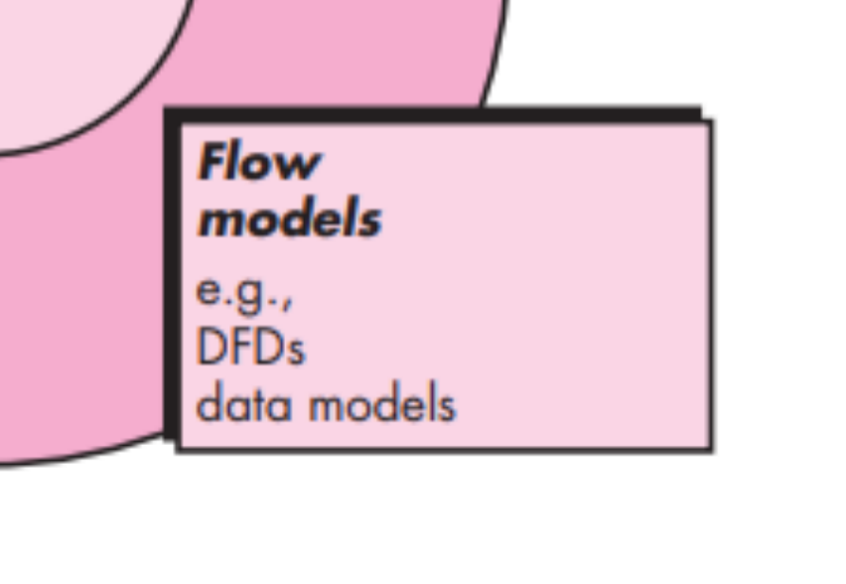

Slide 36
Data Flow Modeling (DFD)
What is a Data Flow Diagram?
A data flow diagram (DFD) is a graphical representation of the movement of data between external entities, processes and data stores within a system.
Simply put, DFD’s show how data moves through an information system

Slide 37
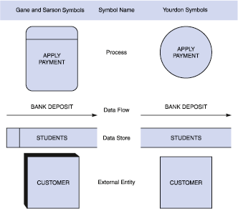
DFD Symbols

Slide 38
Process
The work or actions performed on data so that they are transformed, stored, or distributed.
Process labels should be verb phrases!

Slide 39
Data Flow
A path for data to move from one part of the system to another.
Data in motion!
Arrows depict the movement of data.

Slide 40
Data Store
Used in a DFD to represent data that the system stores
Data at rest!
Labels should be noun phrases

Slide 41
Advantages of DFDs
Simple graphical techniques which are easy to understand
Helps define the boundaries of the system
Useful for communicating current system knowledge to users
Explains the logic behind the data flow within the system
Used as the part of system documentation file

Slide 42
Creating Data Flow Diagrams
Example
Construct Context Level DFD (identifies sources and sink)
Create a context level diagram identifying the sources and sinks (users).
Context Level DFD
Customer Order
Serve Product
Collect Payment
Produce Product
Store Product
Order Raw Materials
Pay for Raw Materials
Pay for Labor
CUSTOMER
Order
0.0
Lemonade System
Sales Forecast
EMPLOYEE
Product Served
Production Schedule
Pay
Payment
Time Worked
Received Goods
Payment
Purchase Order
VENDOR

Slide 43
Creating Data Flow Diagrams
Example
Construct Level 0 DFD (identifies manageable sub processes )
Create a level 0 diagram identifying the logical subsystems that may exist.
Level 0 DFD
1.0
Sale
Customer Order
Serve Product
Collect Payment
Produce Product
Store Product
Order Raw Materials
Pay for Raw Materials
Pay for Labor
Customer Order
Sales Forecast
Product Ordered
CUSTOMER
Payment
2.0
Production
EMPLOYEE
Product Served
Production Schedule
Received Goods
Inventory
VENDOR
3.0
Procure-ment
Purchase Order
Order Decisions
Payment
Pay
Time Worked
4.0
Payroll

Slide 44
Advantages of DFDs
Simple graphical techniques which are easy to understand
Helps define the boundaries of the system
Useful for communicating current system knowledge to users
Explains the logic behind the data flow within the system
Used as the part of system documentation file

Slide 45

Thanks for your attention!
Any Question?
Email me on : junaidakram@cuilahore.edu.pk

